Slide 1
Flow Charts
Objective: to learn how to read and create flow charts
Work Hours: 1 for formative and lecture Participation

Slide 2
Definition
A Flow Chart is a diagram that graphically depicts the steps that take place in a program.

Slide 3
Why To Use Flow Charts
Easy to see the flow of the program.
People that are more visual/graphical learners tend to find it easier to follow.
Useful for designing user interfaces or high level game flow.

Slide 4
Common Symbols
Start/End Points
On Page Reference
Process (action)
Off Page Reference
Input/Output
Database
Decision

Slide 5
Simple Examples-Processes

Slide 6
Example – Output
Both input and output actions can be represented using a parallelogram.

Slide 7
Example – Decision Statements
How are these different?

Slide 8
Example Subroutines

Slide 9
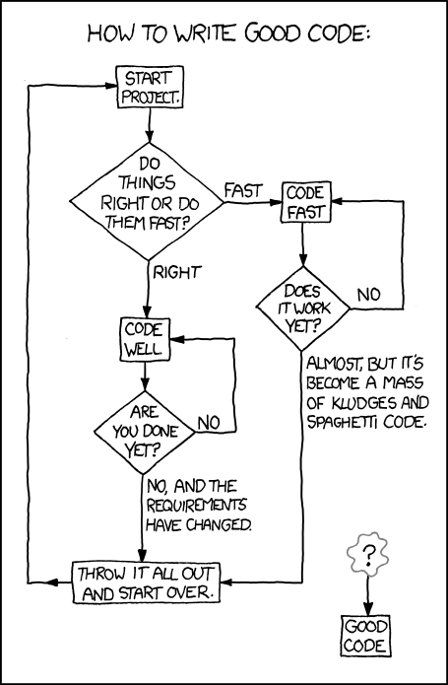
xkcd.com/844/

Slide 10
What do the flow charts represent?
Work Hours: .5
See visio document

Slide 11
Create a flow chart
Work Hours:2
Create a flowchart for one of the following scenarios, make it as detailed as possible, use decision, input/output, subroutine and process symbols.
A typical day of you life – could be a small part of the day what steps do you do what decisions do you make?
Playing some game – go from the start of the game to the end what actions do you take? What choices do you make? What types of things are you looking for that influence your decisions?
A hobby you are interested in
Something else as long as it has enough details.
Should have at least the following:
15 Process Blocks
5 Decision Blocks
1 subroutine (with at least 2 calls)

